Slide 1
Lab on a chip application
Pharma (R&D in drug development, quality control, screening)
Environment (water monitoring, pollution)
Medical (Allergen detection, toxicology, implantable drug delivery system, flow meters in biomedical implants, tailored medication)
Life Science (Diagnosis of disease, gene identification)
Industrial Pollution Control (Bioreactors, food composition to check pesticides and antibiotic residue
Forensic medicine

Slide 2
Other applications
Microreactor
Contacting in extraction
Heat exchanger in electronic circuits
Microdroplet as templates

Slide 3
Advantages of lab on chip
Shorter time
Upfront capital investment – reduced
Close to real time measurements (Blood, food, effluent samples
Small requirement of samples – smaller chemical footprint
Digital output and interfacing with software
In drug discovery, small volume of expensive reagents, parallel operation, high throughput screening, reduced human error

Slide 4
Advantages …..contd.
High surface to volume ratio → Increased catalytic activity and better heat dissipation for highly exothermic reaction → reduced coking, thermal run-away, sintering.
Robustness of the reactor
Hazardous reaction at the point of use
Difficult reaction that requires precise control, and otherwise attainable in a randomly packed bed (e.g., propellant from CO₂ in space-ship)
Others

Slide 5
Components of lab on chip
Pumping
Centrifugal force
Surface force
Electrokinetic force
mechanical
Valve
Hydrogel
Hydrophobic layer
Mechanical
Separation
Field flow fractionation (electrical, thermal, flow)
Electrophoresis, Dielectrophoresis, DEP + FFF
Diffusion based separation (H-Filter)

Slide 6
Components of microfluidic device ..contd.
Mixing
Passive using grooves, laminations
Active
Diffusion between layers
T-Sensor
Heating
Cyclic heating for PCR reaction – DNA hybridization
Detection
Optical interrogation
Amperometric sensing
Flow is laminar and the interaction between layers are utilized in most of these components

Slide 7
Pumping
Use of moving parts as in a conventional pump with the help of micromachining.
Centrifugal force to drive fluid through channels in radial direction (lab on CD).
Use of coating with favorable contact angle, and pillars in the channel to enhance a “capillary rise” type flow.
Electro-osmosis: Polar liquid in contact with solid wall induces surface charges, which in turn influences migration of charges within the liquid near the wall. Voltage gradient along the length of the channel pulls the charges, and the bulk liquid along with it.
Electro-wetting: The change in contact angle of a droplet on a surface when an electric field is present at an interface. A droplet is held between two sets of planar electrodes (upper one consists of single continuous ground electrode, and bottom one with an array of independently addressable control electrodes). By spreading the droplet using the electric field such that droplet touches adjacent electrode in the array, and then switching on the adjacent electrode – movement of droplet is accomplished.

Slide 8
T-sensor
Sample Stream:
Sample antigen to be measured (SA)
Fluorescently labeled antigen (LA) kept to a concentration 2-3 orders of magnitude less than anticipated SA concentration
Other Stream:
Known concentration of antibody (AB) to the target analyte
AB molecules are larger and slow to diffuse
AB binds with all LA if SA is not target analyte → Bound LA cannot diffuse into AB stream → color stays near interface
AB binds with SA and some LA if SA is target analyte → Lot of free LA and free SA to diffuse into AB stream → spread of color into AB stream.
More than one T-sensors in the chip with different AB to target analyte.
Spread of color can be determined digitally.

Slide 9
H-filter
Two parallel laminar streams will flow. One is the sample stream (e.g., blood containing aggregates of different sizes). The other is acceptor reagent (e.g., saline water).
Smaller molecules diffuse faster.
Smaller components of the sample stream will diffuse into the acceptor stream.
At the end of the channel, two parallel flows are split up into two reservoirs.

Slide 10
Detection
Laser induced fluorescence system
Fluorophores are conjugated with migrating analytes
Laser beam excites the fluorophores
Resulting fluorescence signal is filtered to block background illumination from the excitation source.
Fluorescence signal is recorded using CCD camera, PMT, APD
Electrochemical
Monitor variation of electrochemical potential as analytes migrate past a working electrode, positioned within the separation channel.
The conductivity is related to the concentration of species.

Slide 11
Electrophoresis
Migration behavior of charged species under the influence of an electric field.
Analytes are suspended in an ionic buffer environment at a specific pH
Each species migrates with a different mobility, allowing them to be resolved as distinct zones, and separated on the basis of size and charge.
Biological macromolecules (e.g., proteins) are analytes
Drag and electrophoretic mobility are the counteracting forces. Gravity is neglected.
In some cases, polymer gel acts as sieving matrix material in the separation channel. The gel matrix reintroduces a size-dependence to the electrophoretic migration.
In gel electrophoresis, analytes travel through the porous gel network with smaller fragments experiencing less resistance and eluting faster

Slide 12
Dielectrophoresis
Particles are separated based on dielectric properties.
A non-uniform electric field is generated by the use of planar and point electrodes.
More polarizable particle will be attracted to strong field region.
DEP can be used as a trap or in FFF mode. In the second case, gravity acts against DEP forces in settling the particles at a particular height in the channel.
Live cells can be separated from dead cells by this method.

Slide 13
Electrical Field Flow Fractionation
Top and bottom walls of the channel comprise of electrodes. Voltage is applied lateral to the direction of flow.
Particles with high electrophoretic mobility will pack more closely to the wall.
Flow in the channel is laminar, and easily characterized (e.g., parabolic).
Each layer moves at different velocity, and particles carried by the layer elutes at different times from the outlet.
Slugs of particles, separated based on their size/charge is detected at the outlet, and identified based on prior calibration.

Slide 14
Other modes of FFF
Flow FFF
Use of transverse flow with membrane attached to wall
Concentration polarization directs the particles to settle in a layer depending on the diffusivity (size).
Laminar flow carries the particles at each layer to downstream with different residence time
Thermal FFF
Diffusivity is a function of temperature and particle size
One of the channel walls is hot, and the other wall is cold – thus creating a thermal gradient across the channel.
Higher molecular weight particles compact more tightly against the cold wall than do lower molecular weight particles.
Because of laminar velocity profile of the carrier, lower molecular weight samples will have a higher average velocity, and elute before higher molecular weight samples – resulting in a fractogram.

Slide 15
Valve made of hydrogel
Posts on the channel with hydrogel jacket around it.
Hydrogel in its expanded state, block the channel.
Contracted hydrogel allows the flow of fluid down the channel.
Expansion / contraction by external trigger (pH or thermal)
Response time is critical. Fractional change in diameter should reach 1.0 within seconds.
Time response can be tailored by selecting the right number of posts and the thickness of the hydrogel layer.

Slide 16
Valve made of hydrophobic layer
A liquid being unable to expand freely, forms an interface with second liquid or gas.
If interface is curved, there is pressure difference across the interface. The pressure is higher on the concave side. The pressure increase is balanced by surface tension forces.
For flow to take place, the applied pressure gradient has to be greater than the capillary pressure.
An abrupt change in the width of the channel causes pressure drop at the point of restriction.
By adjusting the width and height of the channel at the constriction, and with wall coating that provides adverse contact angle, it is ensured that flow can take place only when pressure at upstream side exceeds pre-specified value.
Similar concept can be used for flow splitting.

Slide 17
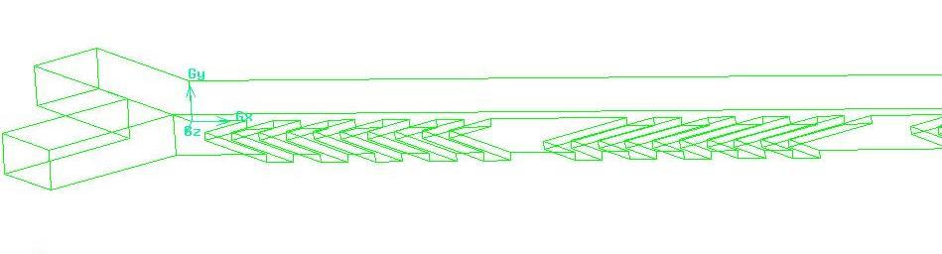
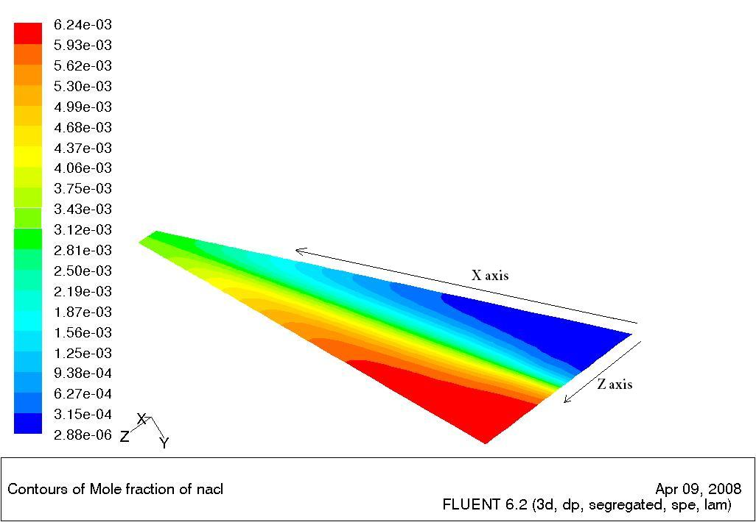
Passive mixing
Diffusion between two parallel streams in laminar flow – enhanced interface between the streams.
Two streams are allowed to intermingle, brought close to each other, and then depart from each other due to baffles in the channel.
Cross-flow between two streams is induced by inclined grooves.

Slide 18
Microfabrication
Fabrication accuracy
City (10 km)---House(10 m)----Optical fiber (1 mm)----Bacteria(1µm)----Virus(0.01µm)---1A°
Traditional mechanical machining
Object of size 1mm to 50 cm
Precision of the order of 10 µm
Special mechanical machining

